Slide 1
Tracking News Topics with
and

Slide 2
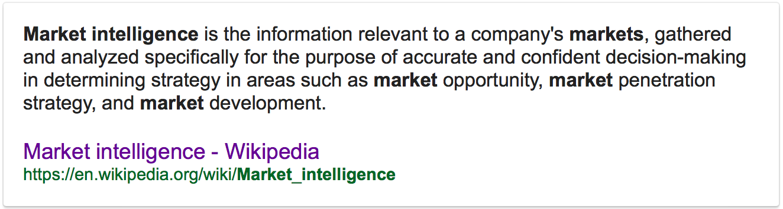

Slide 4
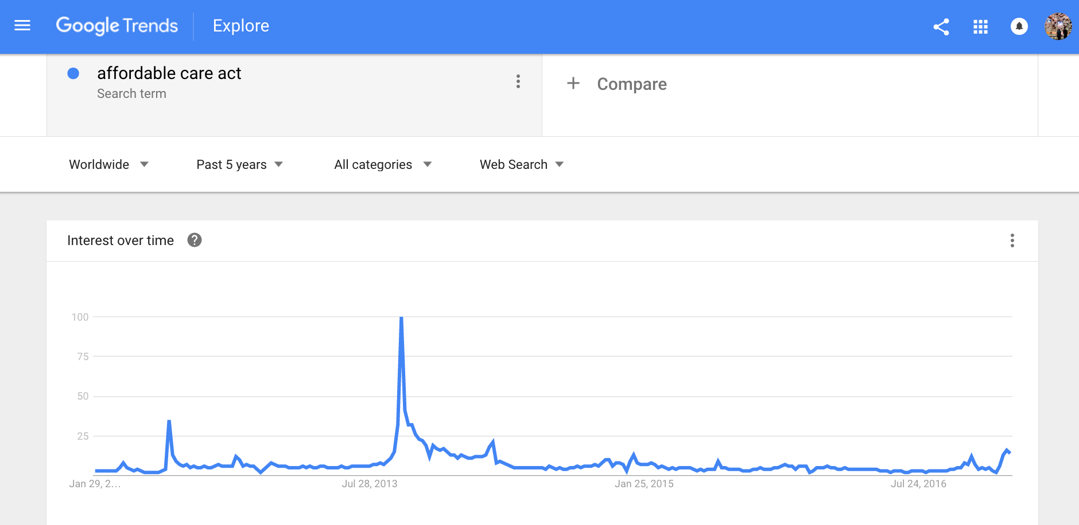

Slide 5
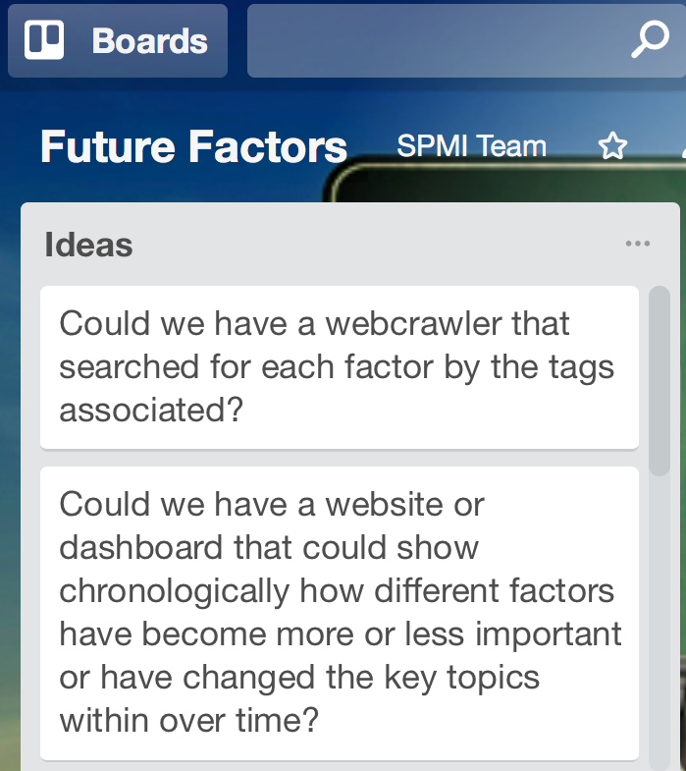


Slide 6
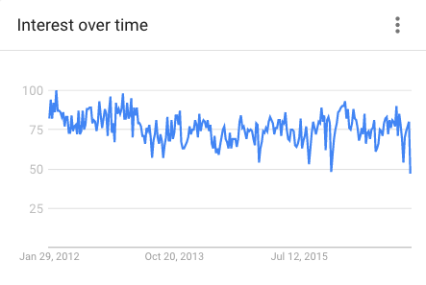

Slide 7


Slide 8
How can we do this?

Slide 9
How can we do this?
1 – collect news stories about health care

Slide 11
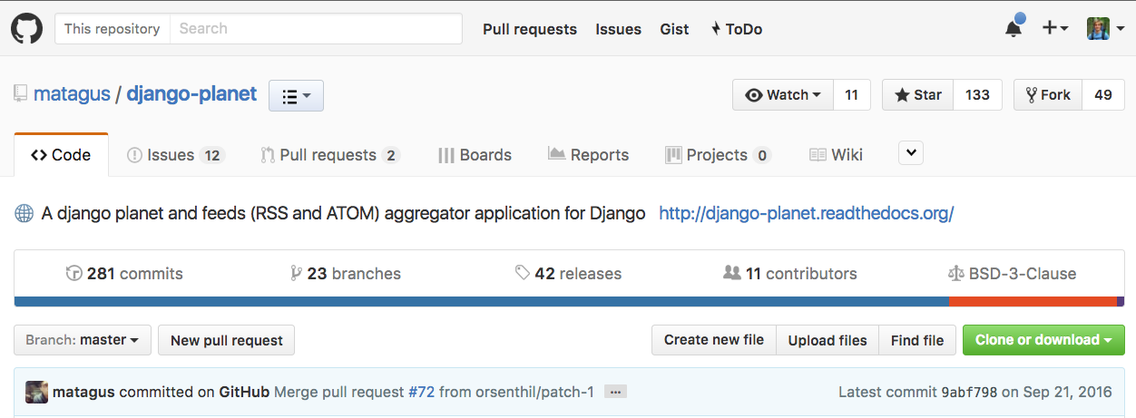
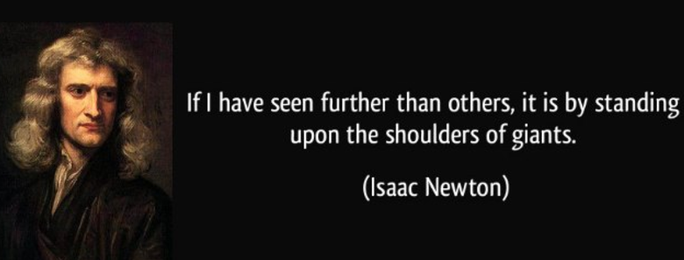
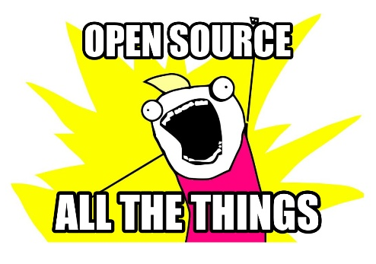

Slide 12
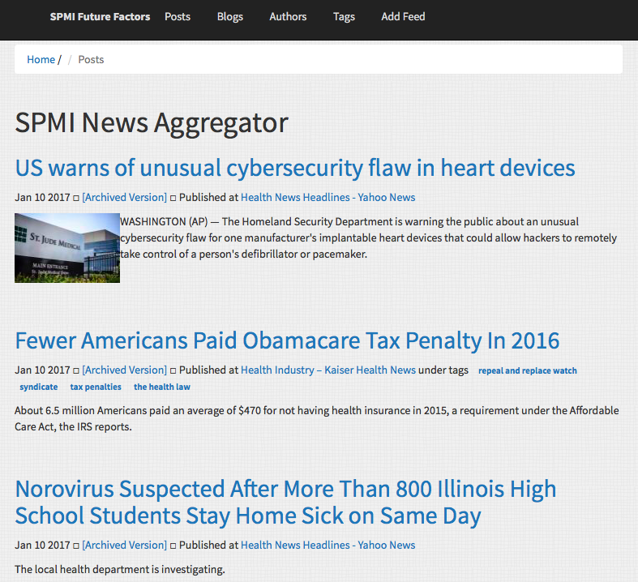
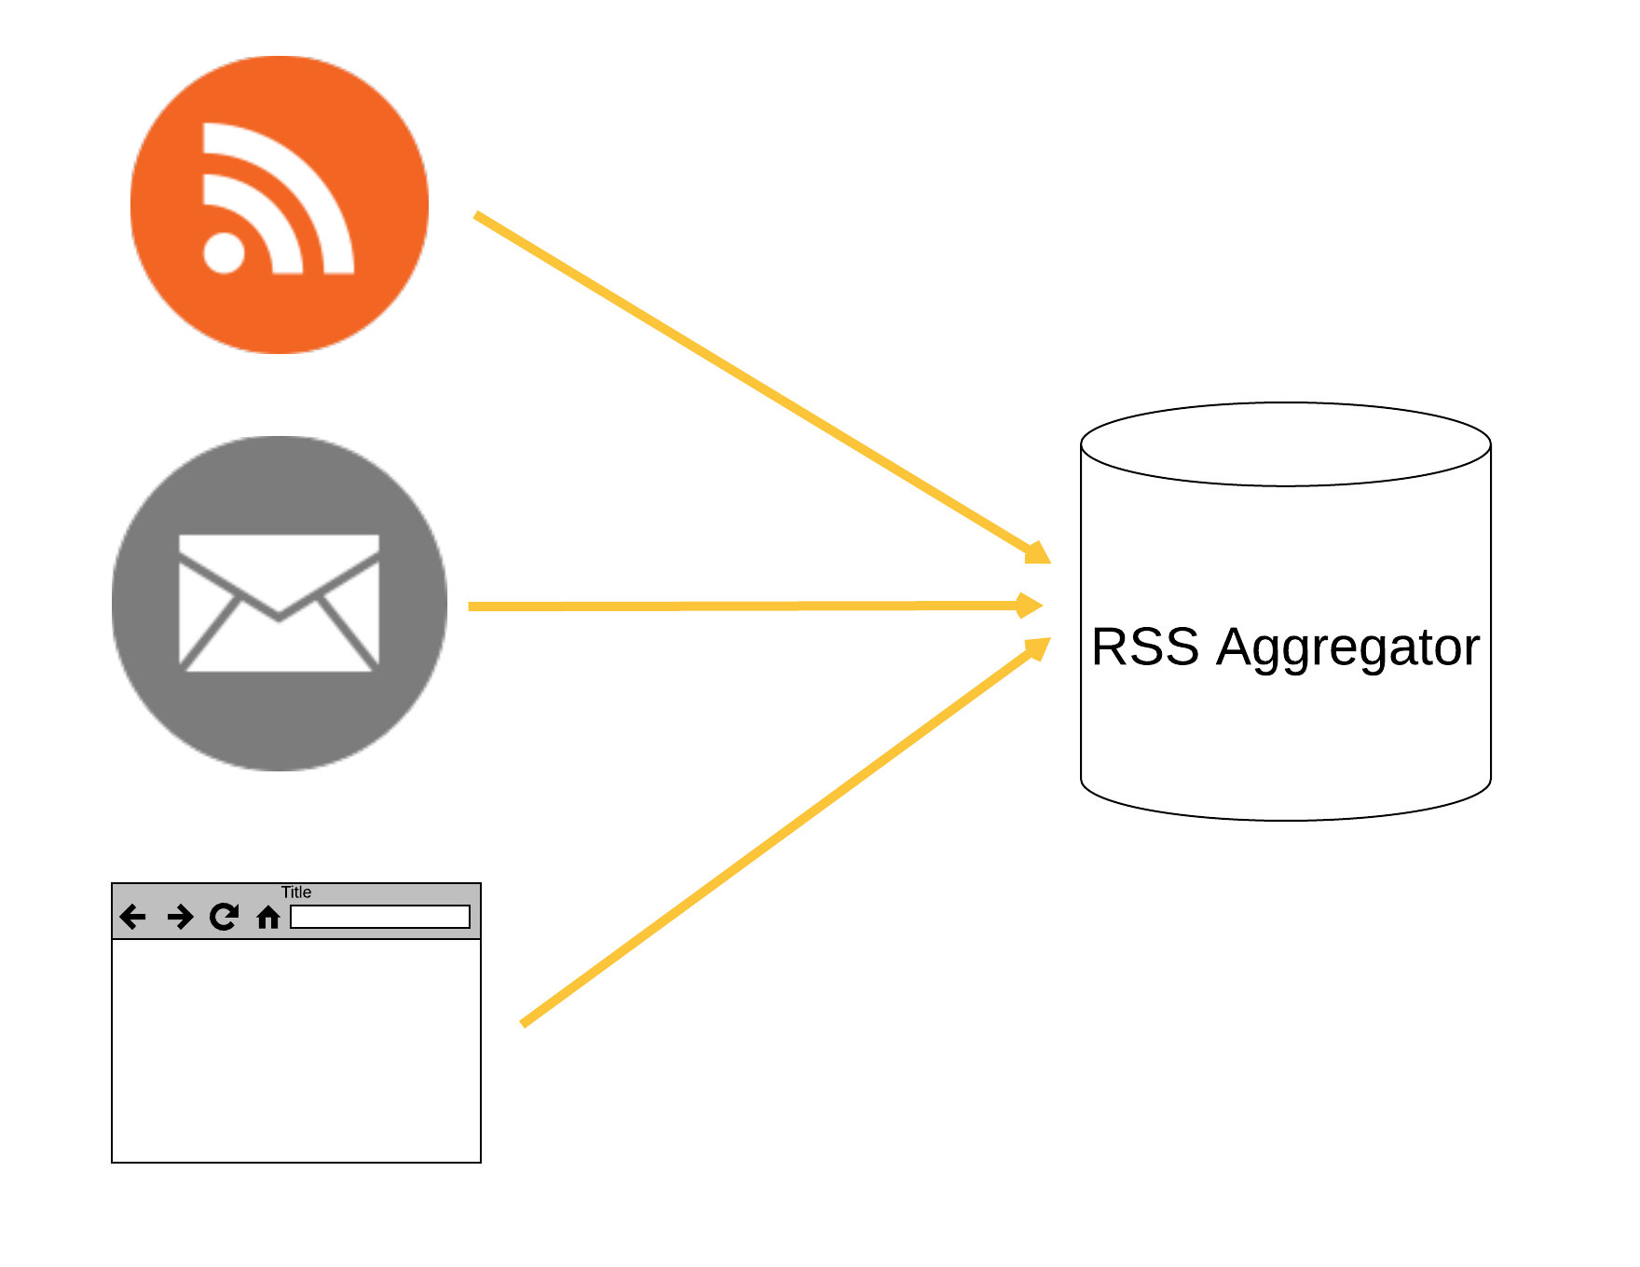
An RSS aggregator continuously gathers health care news stories from ~100 sources
>16,000 stories!

Slide 13
How can we do this?
1 – collect news stories about health care
2 – figure out what stories are talking about

Slide 14

Natural language processing identifies topics being discussed in each news article

Slide 15

Let’s walk through an illustrative example

Slide 16
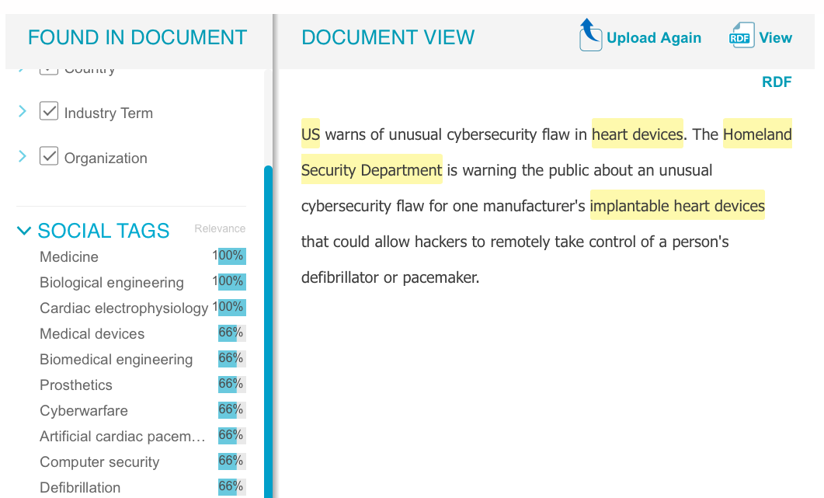
News story headline and summary text is submitted to Open Calais API

Slide 17
Associated tags are retrieved and stored in database for further analysis

Slide 18
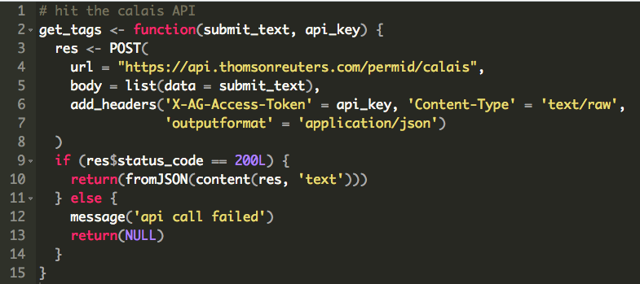

Slide 19
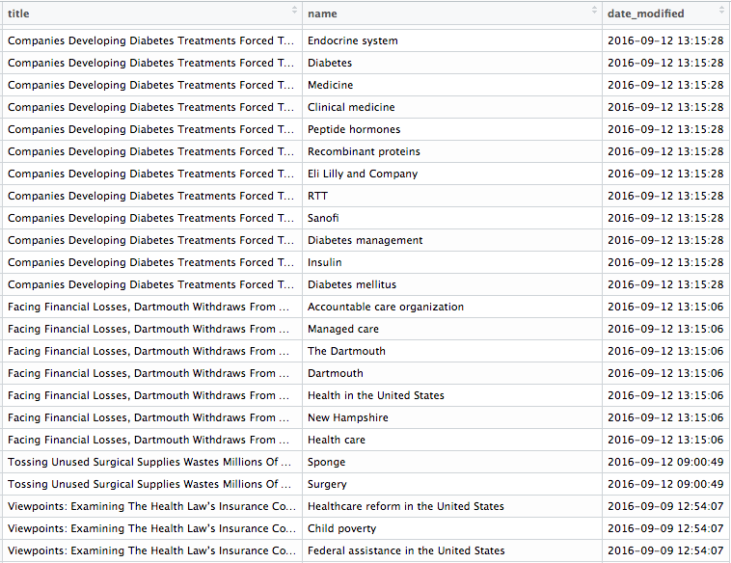

Slide 20
How can we do this?
1 – collect news stories about health care
2 – figure out what stories are talking about
3 – identify common themes among tags

Slide 21
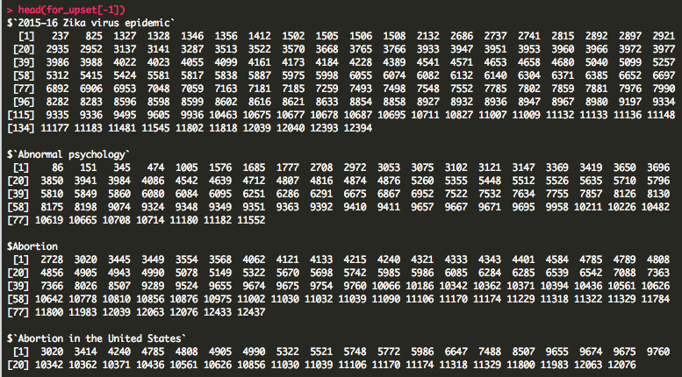

Jaccard index is used to compute “distance” between tags to allow for clustering into topics
$$J\left(A,B\right)= \frac{A ∩B}{A ∪B}$$

Slide 22
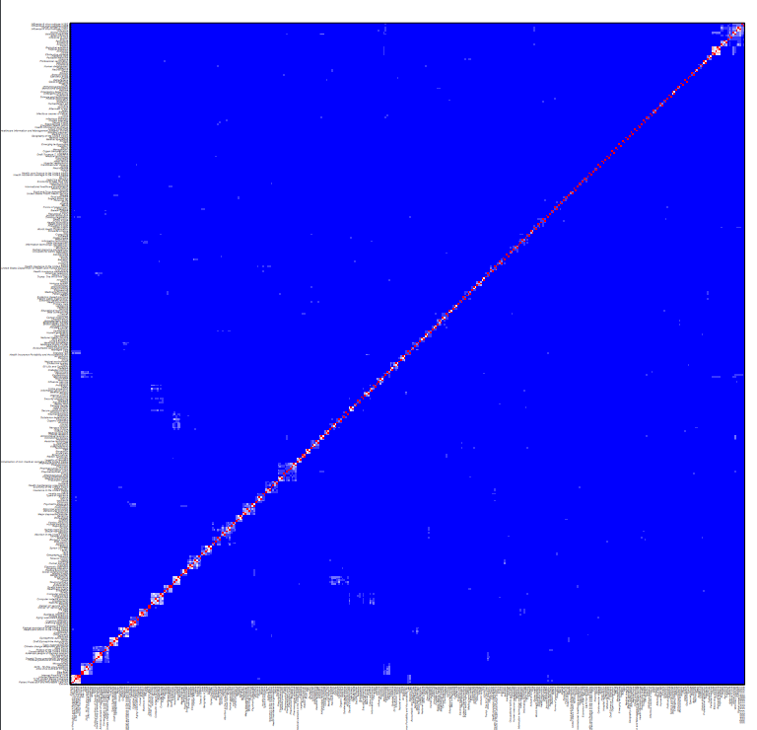

Slide 23
How can we do this?
1 – collect news stories about health care
2 – figure out what stories are talking about
3 – identify common themes among topics
4 – monitor how themes change over time

Slide 24
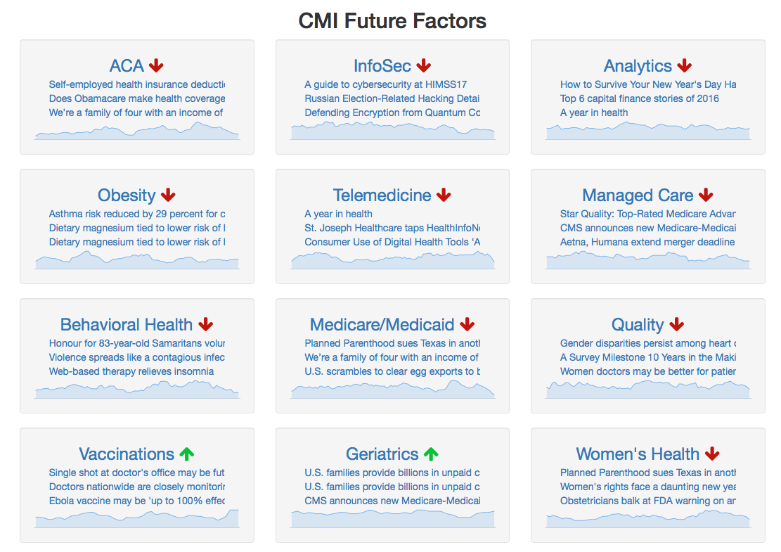
Popularity of selected topics is tracked longitudinally on Shiny app

Slide 25
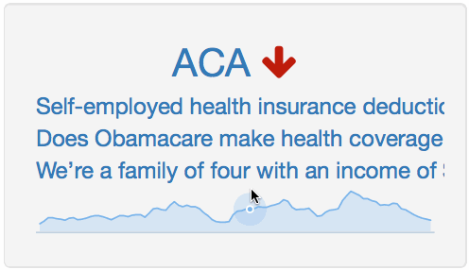
Recent stories associated with each topic are given along with indication of whether popularity is up or down

Slide 26
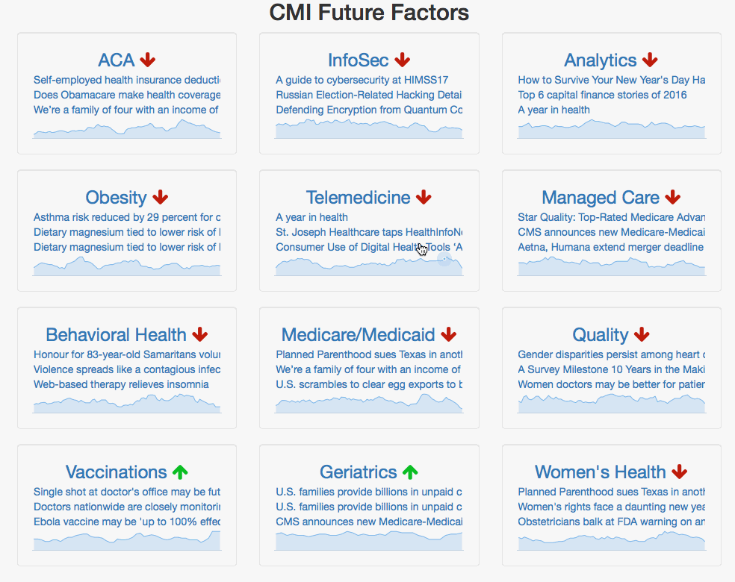
Clicking on topic allows for interrogation of time series

Slide 27

Questions?

